Slide 1

CSCI-6660 Intro Artificial Intelligence
Team Members
Bala Venkata Yaswanth Kommuru – 00787234
Prathima Chowdary Tummala – 00791386
Sai Tarun Reddy Pappu - 00802951

Slide 2

Detection of Credit Card Defaulters Using Machine Learning

Slide 3

Motivation for Project Selection
Relevance and Impact: Credit card default is a significant issue for both financial institutions and individuals. Developing a reliable system to predict and detect potential defaulters can help mitigate financial risks and losses.
Data Availability: Credit card transactions generate a vast amount of data, including transaction history, spending patterns, and payment behavior. Access to such data makes it feasible to apply machine learning algorithms for predictive analysis.
Innovation and Learning Opportunities: Developing a machine learning model for credit card defaulter detection provides a valuable opportunity for innovation and learning. It allows practitioners to explore various algorithms, feature engineering techniques, and model evaluation metrics.
Industry Demand: The finance industry is increasingly adopting machine learning techniques for various applications, including risk assessment. Choosing a topic aligned with industry demands can open up opportunities for collaboration and practical implementation.

Slide 4

Project Objectives
Machine learning techniques are sweeping the commercial world, and the internet is already flooded with ML models ranging from ecommerce to human care, and the list goes on.
We are predicting credit card defaulters in this project by training a data set using several machine learning techniques and comparing the results of each model. Machine Learning models that we are using here are:
SVM
Logistic Regression
Naive bayes
Random Forest

Slide 5

Approach
Get the data set via the API.
Exploratory data analysis.
ML model is used to train the data set.
Predict the model with Test data.
Metrics – Confusion matrix , F1 score, K Fold cross validation.

Slide 6

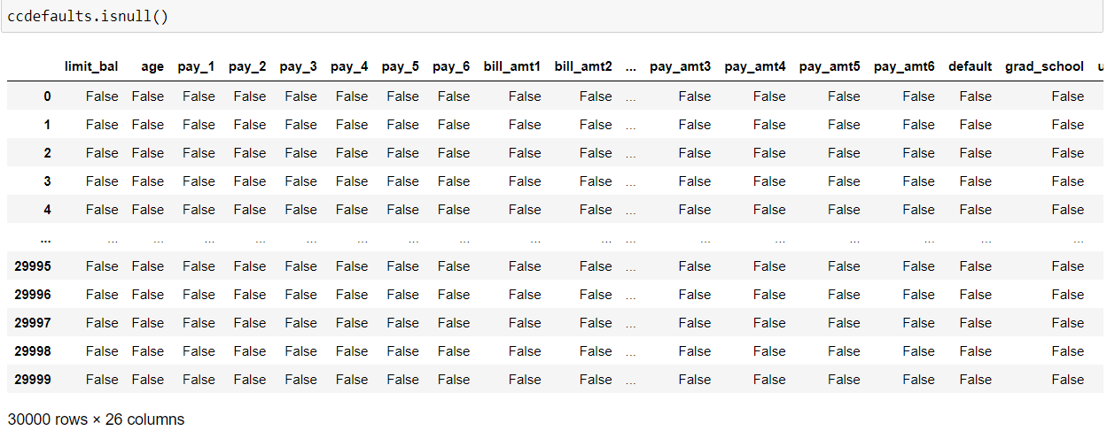
Feature Analysis
In the data set, We looked for any missing values.

Slide 7

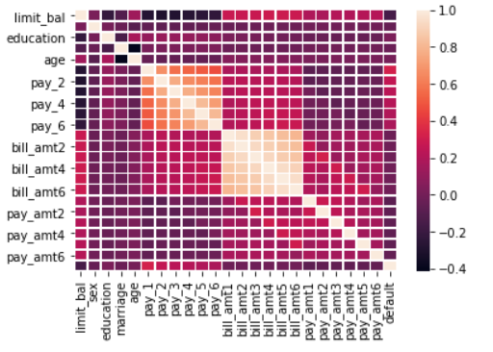
Feature Analysis
2. Correlation between features.

Slide 8

Feature Analysis
Find unique values in few columns.
Transform the education and marital status columns' values.
Set 'default’ as target and create a new dataset by dropping this column from original dataset.
Use RobustScaler to transform the new data set from above.

Slide 9

Model Development Workflow
1. **Data Preparation:**
- Created Train and Test Datasets.
2. **Model Selection:**
- Imported ML models from SKLearn.
3. **Training:**
- Trained models using the Train Dataset
4. **Evaluation Metrics:**
- Utilized F1 Score and Confusion Matrix for model assessment.
5. **Cross-Validation:**
- Applied K-Fold Cross Validation for robust model evaluation.
6. **Testing:**
- Used a new dataset to test model performance

Slide 10

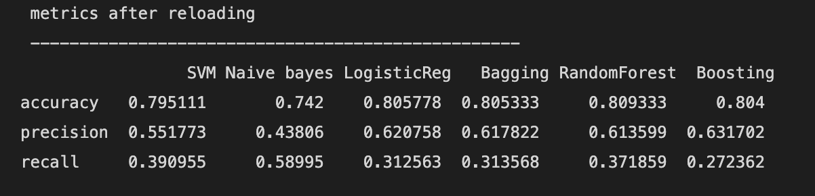
Performance
1. Following is the performance of each models used.

Slide 11

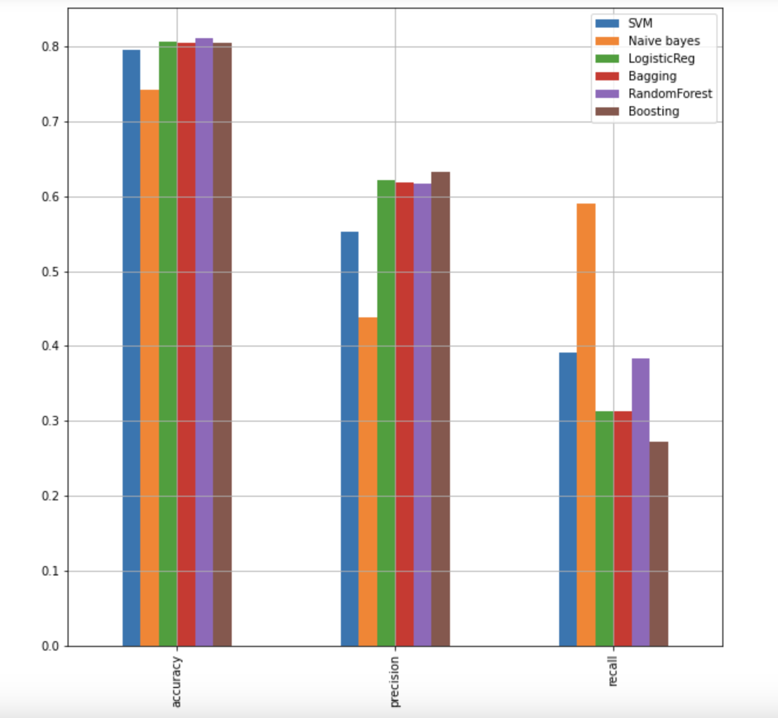
Performance
2. Representing the performance of model visually by plotting bar graph.

Slide 12

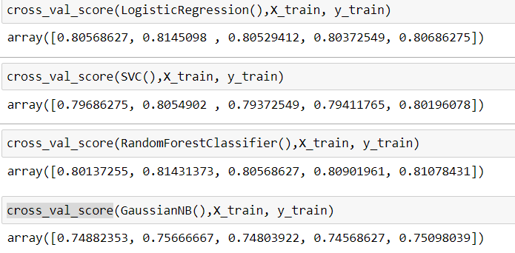
K Fold Cross Validation
We also used K Fold Cross Validation to assess the models.

Slide 13

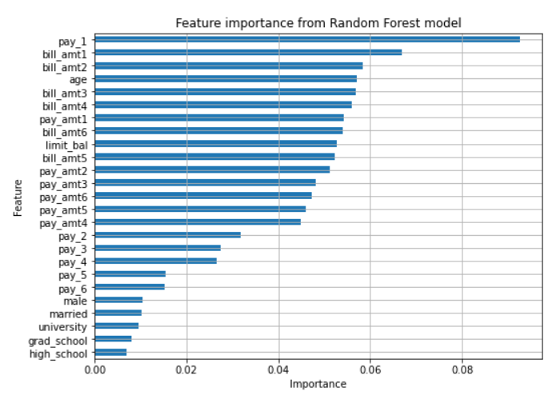
Calculating Feature importance for Random Forest
We calculated important features of the Random Forest Model because it performed well in comparison to other models.

Slide 14

References
https://rstudio-pubs-static.s3.amazonaws.com/281390_8a4ea1f1d23043479814ec4a38dbbfd9.html
Data retrieved from : https://archive.ics.uci.edu/ml/datasets/default+of+credit+card+clients
https://raw.githubusercontent.com/MLWave/Black-Boxxy/master/credit-card-default.csv

Slide 15


